Slide 1
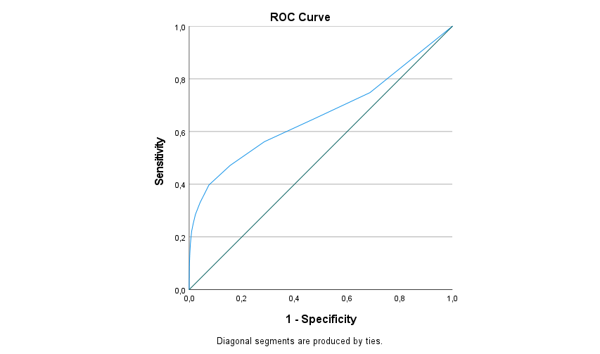
Fig S1. The receiver operating characteristic (ROC) curve of AUDIT points for detecting a prenatal alcohol disorder
Youdens index
Area under the curve (AUC): 0.66 (95% CI 0.65,0.68)

