Slide 1
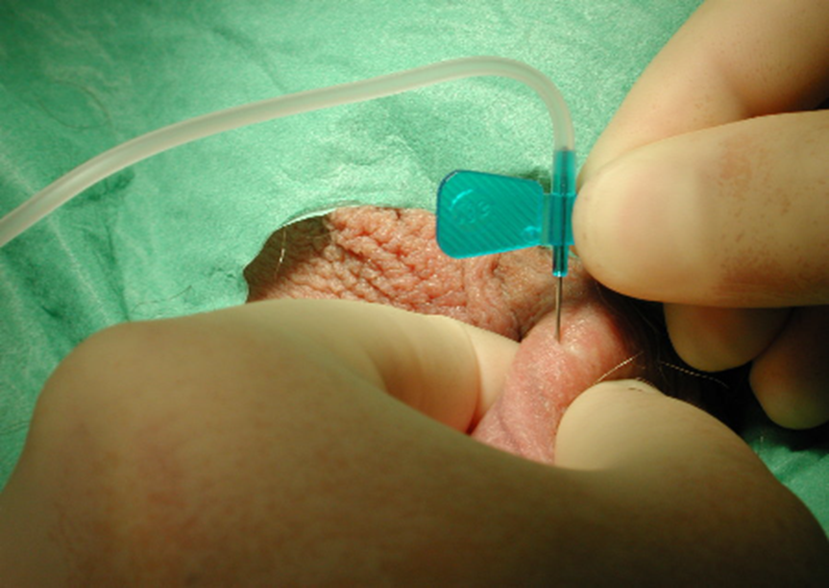
Supplementary material for Westlander G. Utility of micro-TESE in the most severe cases of non-obstructive azoospermia, Upsala Journal of Medical Sciences, 2020
Suppl Fig 1 a. Percutaneous epididymal sperm aspiration (PESA)

Slide 2
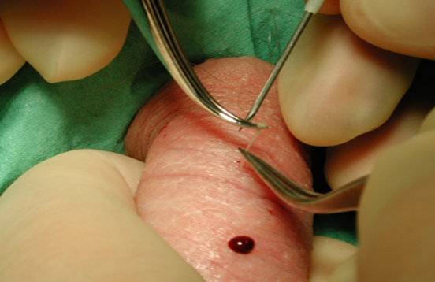
Suppl Fig 1 b. Testicular sperm aspiration
(TESA)

Slide 3
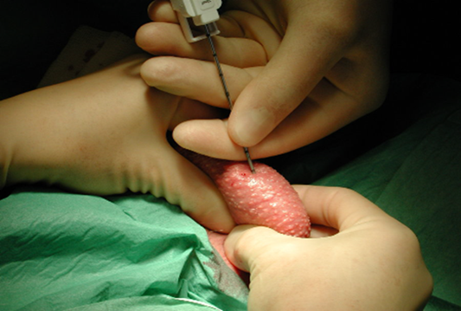
Suppl Fig 1c. Percutaneous biopsy

Slide 4
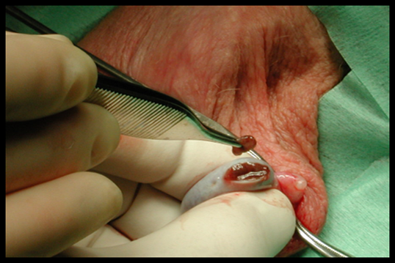
Suppl Fig 1 d. Conventional TESE
(cTESE)

Slide 5
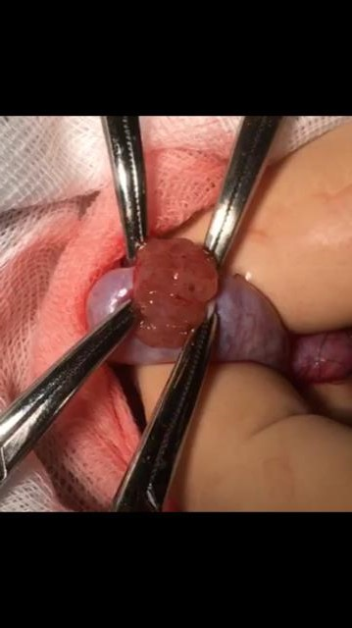
Suppl Fig 1 e. MicroTESE
(MD-TESE)

